Slide 1
PARKING MANAGEMENT SYSTEM
-By Team Coorg

Slide 2
PROBLEMS
Not enough spaces!
Spaces are too far away!
It costs too much!
I got a Ticket!!!!!!
I did not know where to park!!
I could not get a permit!
The parking staff is RUDE!!

Slide 3
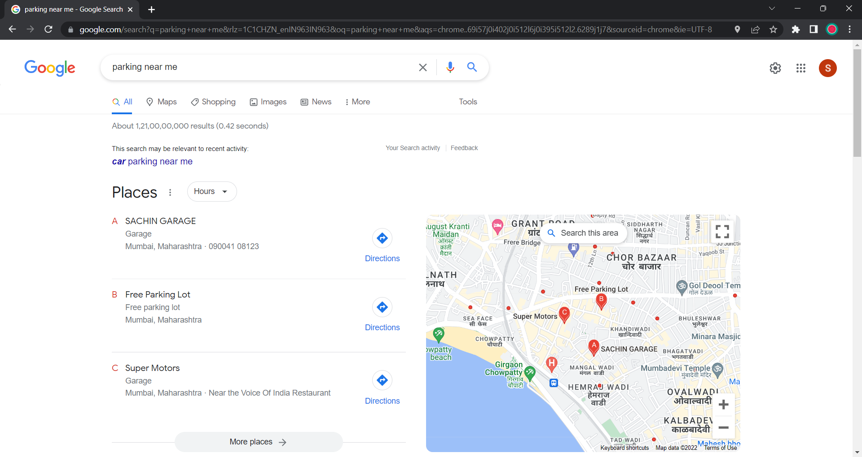

Slide 4
BENEFITS
Less Stress
Improve the overall image of the campus
Give you peace of mind
Increase staff time and energy
Increase revenue
Improve customer satisfaction

Slide 5
WHO ARE THE CUSTOMERS?
Students, faculty, and staff
Special events patrons (sports events, concerts)
Any parking patron
Monthly or hourly parkers
Persons with disabilities
Patients
Violators (those who have tickets)

Slide 6
BUSINESS MODEL
B2B SAAS
B2C

Slide 7
Working
If a person needs a parking space near the location they are currently at they can use our parking system app.
Firstly, they need to enter the app and register(For new user) and login through credentials and allow the app access to their location.
The app then tracks their location.
After successfully locating the location with the help of Google Maps, the app shows a list of parking places near the person’s location.
These locations are retrieved from the database.
Then the app also provides a real time update to the user of whether the parking spaces shown have availability of parking at the present time.
This feature is integrated with the help of camera sensors and machine learning.

Slide 8
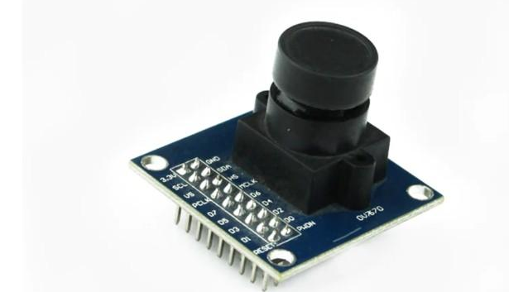
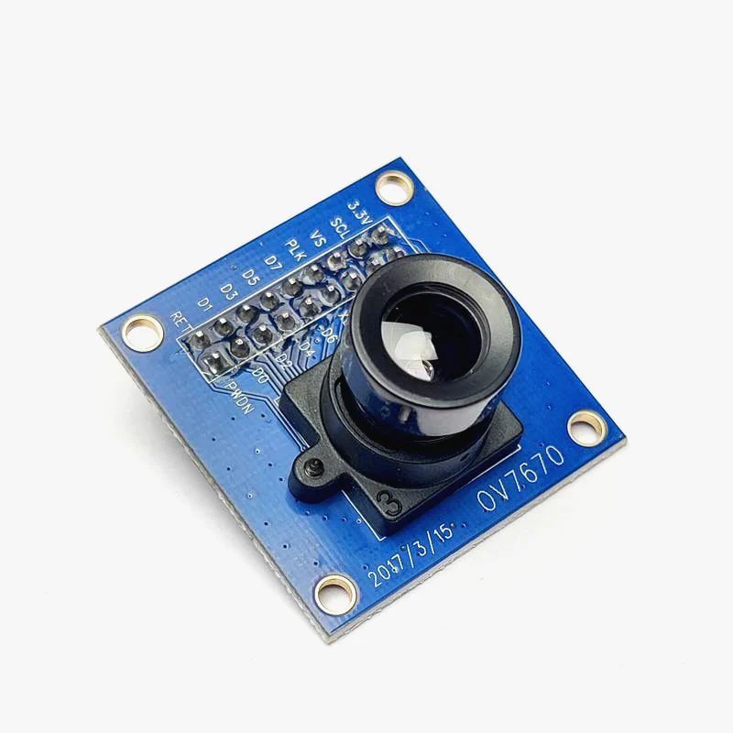
Sensor for Detecting Object
This 0.3 Megapixel OV7670 Camera Module is a great starting point of your foray in the world of image processing and machine learning.
This Camera Module has an image array capable of operating at up to 30 frames per second (fps) in VGA; with complete user control over image quality, formatting and output data transfer.
All required image processing functions, including exposure control, gamma, white balance; colour saturation, hue control and more, are also programmable through the SCCB interface.
https://cdn.shopify.com/s/files/1/0300/6424/6919/products/OV7670-Camera-Module_1024x1024.jpg?v=1665745815

Slide 9
Specifications
3 MegaPixel Resolution
I/O Voltage: 2.3V
Angle of View= 67ᵒ
Highly sensitive
Maximum Frame Rate= 30FPS VGA
Working temperature: -30ᵒC to 70ᵒC
Package Contents
1×0.3Megapixel OV7670 Camera Module

Slide 10
THANK YOU!

